Slide 1


Customer Churn Analysis
Using
Presented by
Ramesh Satta

Slide 2
Problem Statement
Why Churn Analysis?
Telecom companies face revenue loss when customers discontinue services. The goal is to measure churn, identify key drivers, segment high-risk customers, and build predictive retention strategies.
Key Questions:
What is the overall business impact of customer churn?
What are the top statistical drivers that predict churn?
Are we losing our most valuable customers?
How much revenue can we save if churn is reduced by X%?
Which customer segments should we prioritize for retention?

Slide 3
Dataset Summary
Total Records: 7,043 customers
Total Fields: 21 columns (10 categorical, 11 numerical)
Key Data Categories
Customer Profile
customerID, gender, SeniorCitizen, Partner, Dependents
Account & Subscription Details
tenure (0–72 months)
Contract (Month-to-month / One year / Two year)
PaperlessBilling
PaymentMethod
Service Usage
PhoneService, MultipleLines
InternetService (DSL / Fiber optic / None)
Add-on services: OnlineSecurity, OnlineBackup, DeviceProtection, TechSupport, StreamingTV, StreamingMovies
Billing & Revenue
MonthlyCharges
TotalCharges

Slide 4
Data Cleaning and quality check
Replaced null values with “0” in TotalCharges column.
Replaced “No internet service” with “No” in below columns:
OnlineSecurity
OnlineBackup
DeviceProtection
TechSupport
StreamingTV
StreamingMovies
100% valid values in all categorical fields
TotalCharges had blanks for tenure = 0 → cleaned & recalculated
Created Tenure Buckets for analysis
Verified there are no duplicate customerIDs
All service columns normalized (Yes / No )

Slide 5
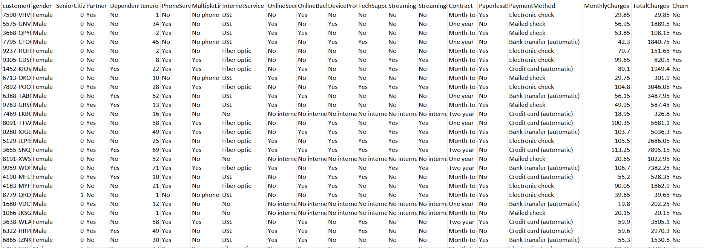
Raw Dataset (CSV)

Slide 6
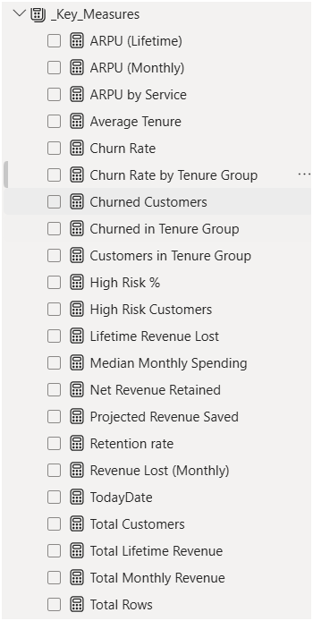
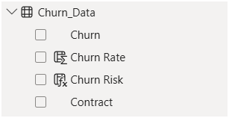
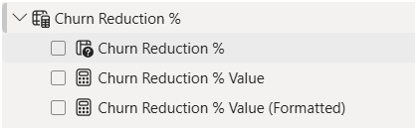

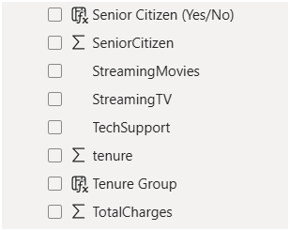
Key measures, calculated columns and Supporting tables
Key Measures
Calculated Columns
Supported tables

Slide 7
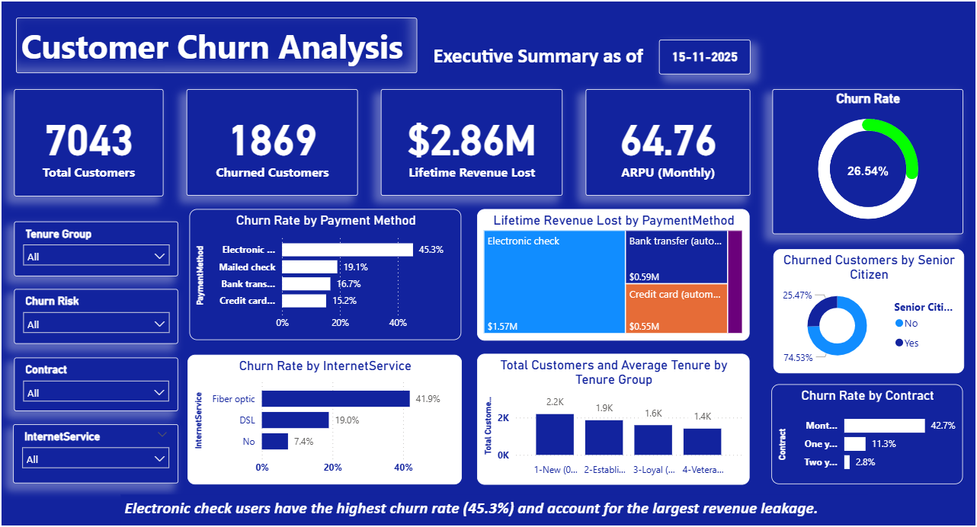
Dashboard-1

Slide 8
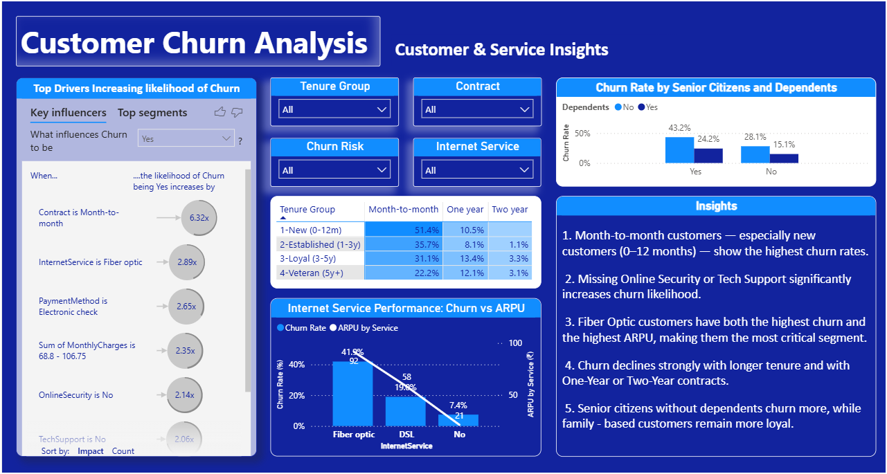
Dashboard-2

Slide 9
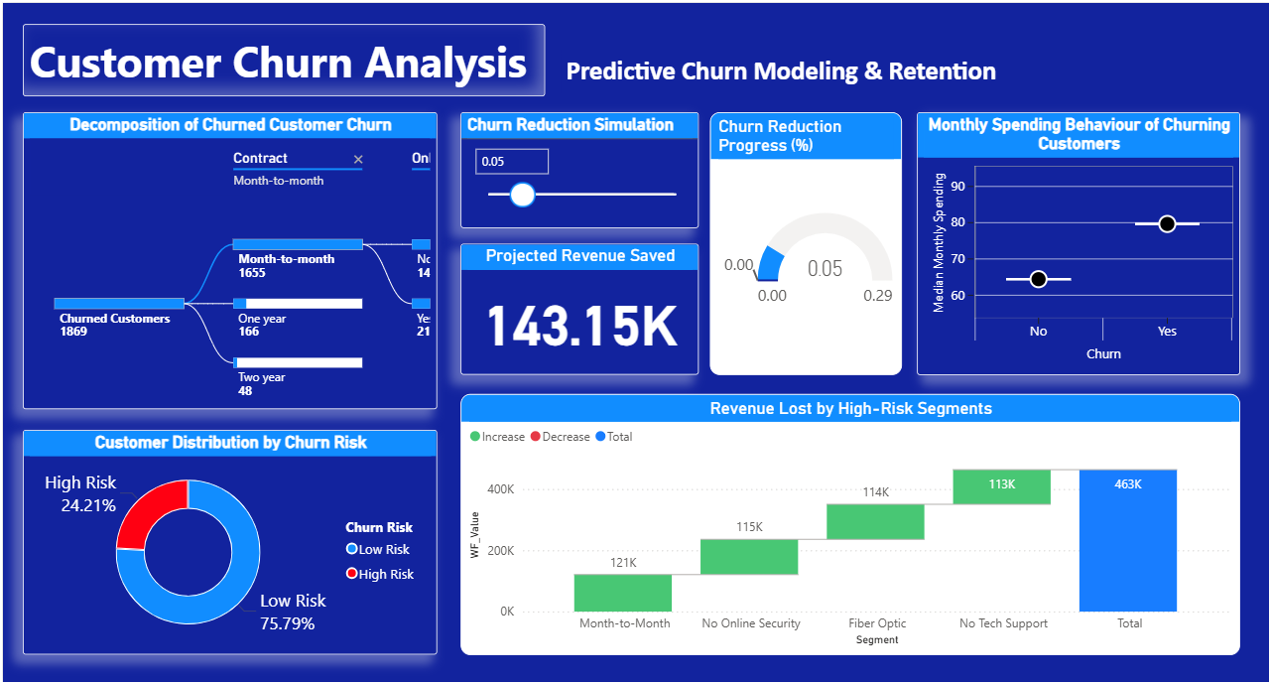
Dashboard-3

Slide 10
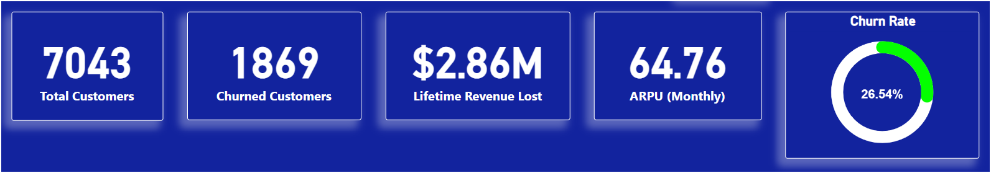
1. What is the overall business impact of customer churn?
Top 5 Insights:
The dashboard analyzes a total of 7,043 customers.
Of these, 1,869 have churned, resulting in a high 26.54% overall churn rate.
The total financial impact of this churn is $2.86 Million in lost lifetime revenue.
The average revenue per customer (ARPU) is $64.76 per month, indicating a high-value customer base.
These KPIs establish a clear, multi-million-dollar problem that requires a data-driven solution.

Slide 11
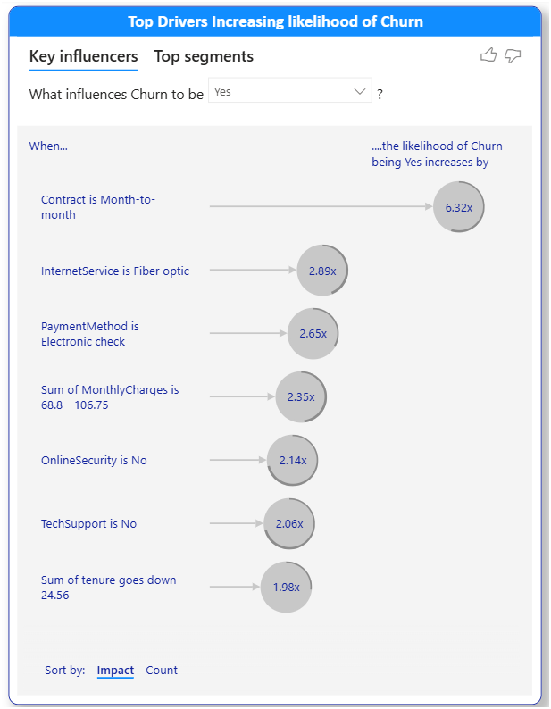
2. What are the top statistical drivers that predict churn?
Top 5 Insights:
The AI model confirms that Contract type is the #1 driver, making a customer 6.32x more likely to churn if they are "Month-to-month."
Lack of add-on services is the next key factor: "OnlineSecurity is No" (2.14x) and "TechSupport is No" (2.06x) are the 2nd and 3rd biggest drivers.
Service type is critical: "InternetService is Fiber optic" makes a customer 2.89x more likely to churn.
Billing method is a significant driver: "PaymentMethod is Electronic check" increases churn likelihood by 2.65x.
This visual provides a clear, prioritized "hit list" of the 5 core problems we need to solve.

Slide 12
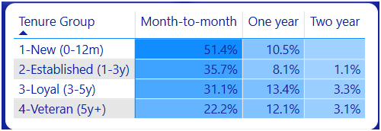
3. What is the "red-flag" segment combining our top drivers?
Top 5 Insights:
The AI model confirms "Month-to-month" is the #1 churn driver, increasing risk by 6.32x.
New (0-12m) "Month-to-month" customers are the highest-risk segment, churning at 51.4%.
Long-term contracts are the best retention tool, dropping churn to as low as 1.1%.
Even veteran (4y+) customers are a risk on "Month-to-month" plans, still churning at 22.2%.
The data proves converting "Month-to-month" customers to 1-year contracts is the top retention strategy.

Slide 13
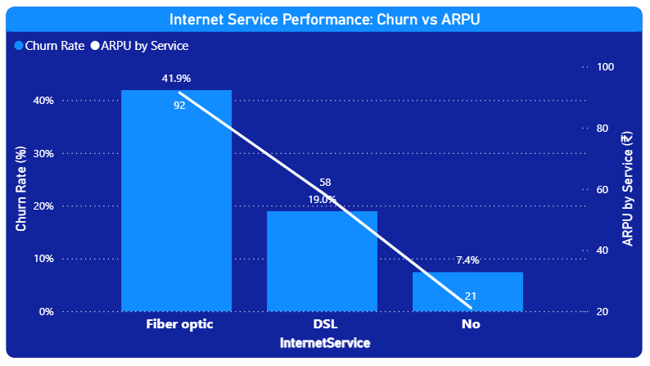
4. Are we losing our most valuable customers?
Top 5 Insights:
Fiber Optic customers are our most valuable (highest ARPU) but also our highest risk (41.9% churn).
DSL customers represent a stable, mid-value segment with a moderate 19% churn rate.
"No Internet" customers are our most loyal (7.4% churn) but also our lowest-value segment.
The data proves we are "losing at the top" by failing to retain our highest-paying Fiber customers.
Reducing Fiber churn is the top priority, as it will save both the most customers and the most revenue.

Slide 14
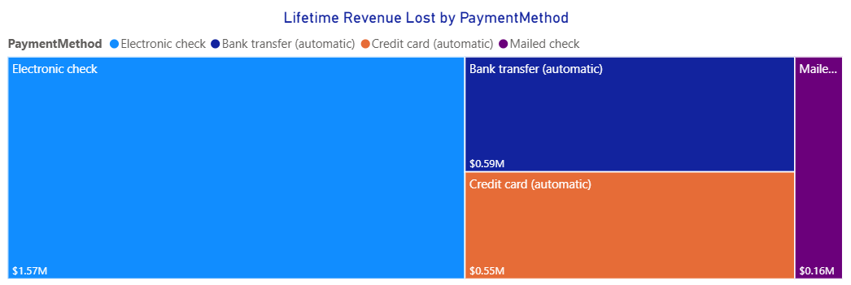
5. Which payment methods are costing us the most money?
Top 5 Insights:
"Electronic check" is the single largest source of lost revenue, totaling $1.57M.
More revenue is lost from "Electronic check" than all other payment methods combined.
Automatic payments (Bank transfer & Credit card) together account for a significant $1.14M in lost revenue.
"Mailed check" is the lowest-risk payment method, contributing only $0.16M to the total loss.
This visual clearly identifies "Electronic check" as the top-priority segment for any revenue-saving retention strategy.

Slide 15
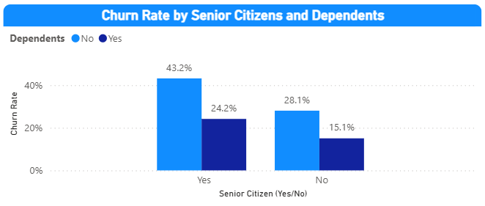
6. What is the demographic profile of a churner?
Top 5 Insights:
Highest-Risk Segment: Seniors without Dependents (43.2% churn).
Safest Segment: Non-Seniors with Dependents (15.1% churn).
Key Retention Factor: Having "Dependents" cuts the churn rate by almost half for both groups.
Seniority Risk: Seniors (43.2%) are 1.5x more likely to churn than Non-Seniors (28.1%) when neither has dependents.
Strategic Implication: We must treat these four demographic segments with unique retention strategies.

Slide 16
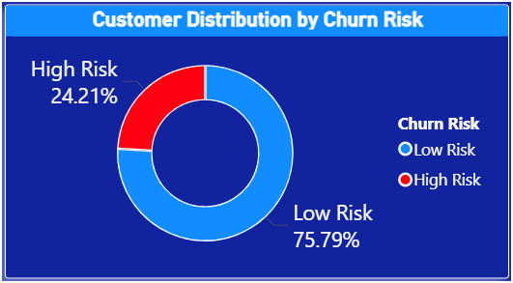
7. How large is our "High-Risk" population?
Top 5 Insights:
Based on our "Churn Risk" model, we have clearly segmented our entire customer base.
24.21% of all customers fall into the "High Risk" category.
This translates to approximately 1,705 customers (24.21% of 7,043).
"Low Risk" customers make up the vast majority (75.79%).
This is a powerful insight: we can now focus our retention budget only on the 24.21% that matter, instead of a "spray-and-pray" approach.

Slide 17
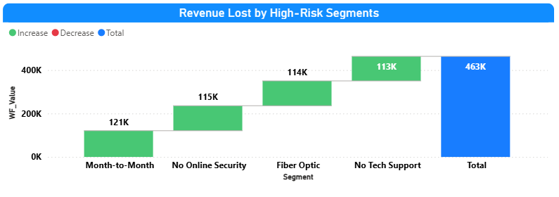
8. What is the exact financial damage from each top driver?
Top 5 Insights:
Month-to-month customers contribute the highest revenue loss among all segments.
Customers without Online Security add a significant second layer of revenue leakage.
Fiber Optic users form a high-value segment with substantial revenue risk.
Lack of Tech Support drives another major block of lost revenue.
All segments cumulatively build up to the total ₹2.86M revenue lost due to churn.

Slide 18
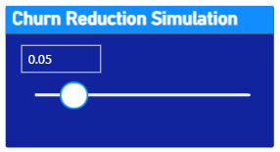
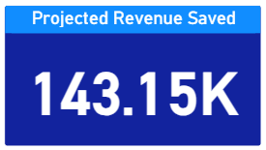
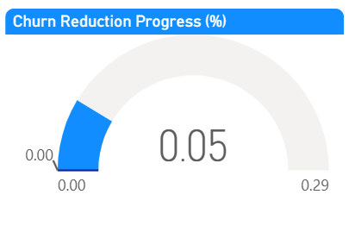
9. How much revenue can we save if churn is reduced by X%?
Top 5 Insights:
Reducing churn by 5% saves approximately ₹143K.
Reducing churn by 10% doubles savings proportionally.
Gauge shows real-time progress toward reduction goal.
Interactive slider enables scenario modeling.
This Tool helps justify retention budget to management.

Slide 19
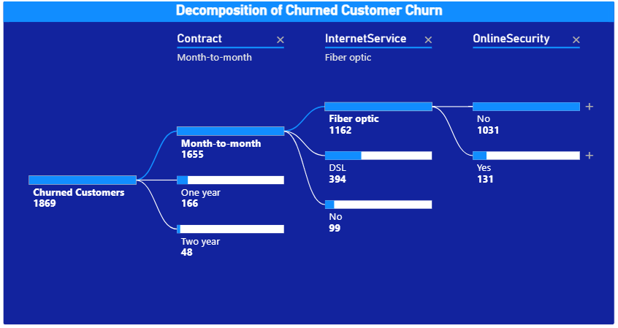
10. Which customer segments should we prioritize for retention?
Top 5 Insights:
Priority 1: New + Month-to-Month + No OnlineSecurity
Priority 2: Fiber Optic + No TechSupport
Priority 3: High-Risk Senior Citizens without Dependents
Priority 4: Electronic-check users (high churn)
Priority 5: High ARPU but High Churn segments

Slide 20
Final Recommendations
Strategic Actions
Encourage contract upgrades to 1-year/2-year.
Bundle or discount OnlineSecurity & TechSupport.
Improve service experience for Fiber Optic users.
Target new customers early with onboarding programmes.
Focus on high-risk segments based on AI-driven analysis.
Monitor churn monthly using predictive insights.
Business Impact
✔ Reduced churn ✔ Increased retention ✔ Higher customer lifetime value ✔ Revenue growth

Slide 21
Thank You

